Slide 1
Introduction to Reinsurance and the Role of a Broker and Broker Analytics
NATHAN SCHWARTZ

Slide 2
What is insurance and why does insurance exist?
Insurance companies allow you to trade an uncertain risk for a certain premium payment
The cost of the risk is higher to you than to the insurance company
Lots of reasons why the cost to the insurance company is higher than the cost to you
Expenses
Adverse selection
Moral hazard
Increased utilization
Fraud
Why would the cost be lower?
Risk sharing (diversification)
Risk expertise (underwriting)
Financial means
Legal or business requirements (e.g. surety or personal auto)

Slide 3
What do insurance companies worry about?
Insurance must be priced before the cost (losses) of policies are known
As long as times are normal and risks are independent an insurance company will have very stable results
Example: 1,000,000 policyholders, each has a 1 in 1000 chance of total loss
Then the insurance company will nearly always have between 925 and 1075 claims
But. . .what if something happens that impacts everyone at once?
Inflation
Changes in law or social norms
Systemic practices
Physical catastrophe events (e.g. hurricanes and earthquakes)
Rating and regulatory requirements
Investors (if a public company)

Slide 4
What is reinsurance and why does reinsurance exist?
Reinsurance is insurance that insurance companies sell to each other
At its most fundamental level, the same reason you might insure a $20k car is the reason that an insurance company might insure a $200M hurricane
Insurance companies use reinsurance to
Stabilize results
Protect capital and surplus
Satisfy regulators and rating agencies

Slide 5


Driving a car looking out the back window

Slide 6
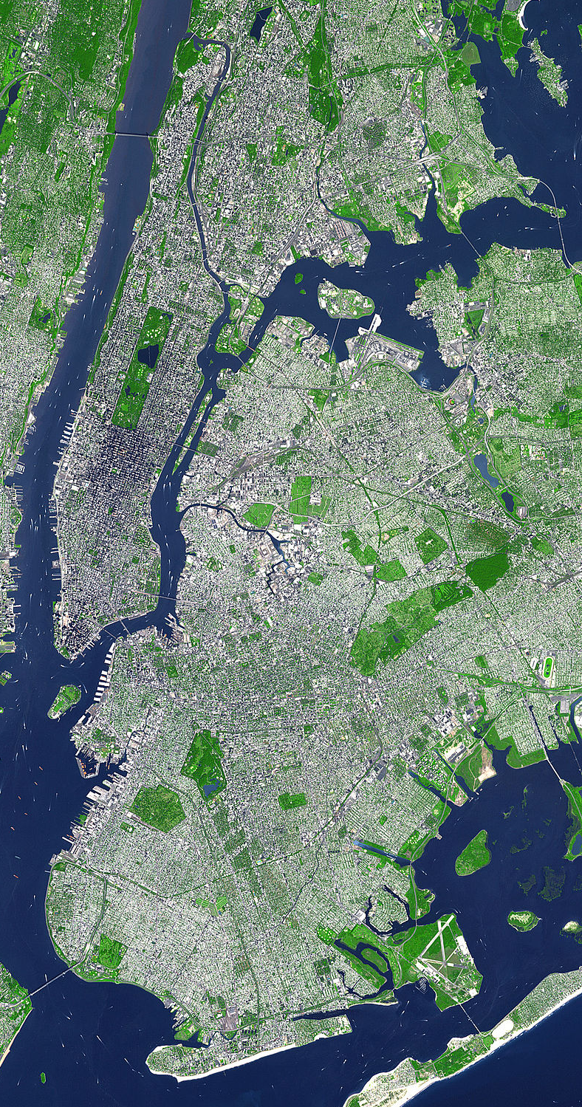
Why does reinsurance exist?
Home policy
$1,000 premium
$200,000 payout for a loss
Insurer based in New York
Markets solely through agents in the New York City area
Builds up a 100,000 policy portfolio in the city over time
Predictable risk from:
Theft
Fire
Accidents

Slide 7

Why does reinsurance exist?
Some risks create correlation in the portfolio
Natural disasters
Terrorism
Pandemics
The portfolio is diversified by types of customers, but not by geography
Solutions:
Expand geographical scope
Expertise
Required capital
Transfer some of your risk to a party that already has a broad geographical scope
To another insurer: competitive issues
To a reinsurer

Slide 8
Why would reinsurance pricing be attractive?
Reinsurers have a different portfolio profile
Insurer’s main risk is NYC; Reinsurer may be concentrated in Florida
Reinsurers are not subject to as much regulation
Insurance is perceived as an essential service for consumers; reinsurance is a free market between sophisticated companies
Reinsurer investors may have a higher tolerance for risk
Insurance investors highly value stable earnings [and dividends]
Reinsurers may have different accounting rules
Reinsurers may have different rating agency/regulatory requirements

Slide 9
How does a company buy reinsurance?
Engage a reinsurance broker
Decide what the key risks are and how to protect those risks
Create reinsurance submissions
Negotiate price and terms
Finalize contracts
Pay premiums
Submit and pay claims

Slide 10
What role does a reinsurance broker play?
Assist with pricing
Brokers know the reinsurance market better
Placing just one deal v placing hundreds
Understanding regulations across jurisdictions
Estimate risk of large losses
Catastrophe modeling
Software
Risk advice
Strategic advice

Slide 11
Key players in an insurance company
Agents / Marketing
Underwriting
Actuary
Risk Management
Reinsurance Buyer
Finance / Accounting
Executives

Slide 12
What role does an actuary play?
Pricing insurance
Pricing reinsurance
Many risk managers are actuaries
Some reinsurance buyers are actuaries
Reinsures use actuaries to price and underwrite deals

Slide 13
What role does a catastrophe modeler play?
Catastrophe models play a similar role to actuaries for catastrophe risk
Develop expected loss
Develop range of results catastrophe losses might be
probable maximum losses (PML)
Most common catastrophe perils:
Hurricane
Earthquake
Convective storm / winter storm / thunderstorm / tornado / hail
Wildfire
Flood
Casualty cat (e.g. Asbestos)
Many others (riot, industrial accident, terrorism, etc)

Slide 14
What role does rating agency support play?
Insurance companies sell a promise to pay future losses
This makes insurance subject to a lot of regulation
RBC is a capital adequacy measure that all US insurance companies must meet
Buyers also look to rating agencies to validate that insurance companies are worth doing business with
A.M. Best
S&P
Demotech
Rating and regulatory considerations can drive reinsurance buying
Maintaining ratings are key to an insurance company’s ongoing viability

Slide 15
Real-life example of leveraging reinsurance
Florida Homeowners Carrier Risk Profile
(USD)
Interesting items to note:
Using a combination of rating agency/regulatory and reinsurance leverage, this insurer wrote protection on $52 billion of exposure using only $41 million of capital
The insurer charged $213 million of premium for this exposure, or about $4 for each $1000
In order to transfer risk to reinsurers, the insurer paid $75 million of reinsurance premium. Net premium is therefore $213m - $75m = $138 million
This $138 million of premium must support:
Commissions to agents
Internal expenses
Non-catastrophe losses
Retention on any cat losses
Total Insured Value (TIV) = $52.4 billion
1 in 1000 (0.1% probability) = $1.75 billion
1 in 250 (0.4% probability) = $1.05 billion
1 in 100 (1% probability) = $580 million
RI limit = 576m
RI premium = 75m
Retention = $4 million
Policies 179,000
Written Premium $213 million
Surplus $41 million
Rating Demotech “A”

Slide 16



Howden Tiger Analytics: Value Proposition
PEOPLE
INSIGHTS
Experienced Cat Modelers
Homeowners and complex commercial
Regulatory and rate filing support
Financial and profitability analysis
Experienced Actuaries
Primary and Reinsurance
Specialty Lines
Experienced Rating Support
Specialty Expertise
Understanding Your Risk
Designing the Most Effective Hedges
Building a Better Portfolio
Improving Results
Event Response
Special Projects
Analytics Summits
BETTER CLIENT RESULTS!

Slide 17
Understand Your Risk: Historical Distribution of Large Losses
Commentary
Focus: How Many Claims Would Excess Reinsurance Cover? (Sum Bar Areas Right of Red Line)
In Addition to Reviewing Policy Limits, Looking at the Historical Loss Potential by Claims Size Provides a View of How Excess of Loss (XOL) Reinsurance can Mitigate Severity Risk
Provides an Idea of How Often a Claim might Exceed the Retention and a Sense for the Future Use of Reinsurance
Note that Depending on the Retention, potentially, Many Claims may not Attach or Use an XOL Reinsurance Program. This Underlying Claim Frequency Risk is Retained.
$5M Retention Would Not Cover 97.8% of Historical Claims Incurred
No Reinsurance Coverage
Example Company
Claim Size

Slide 18
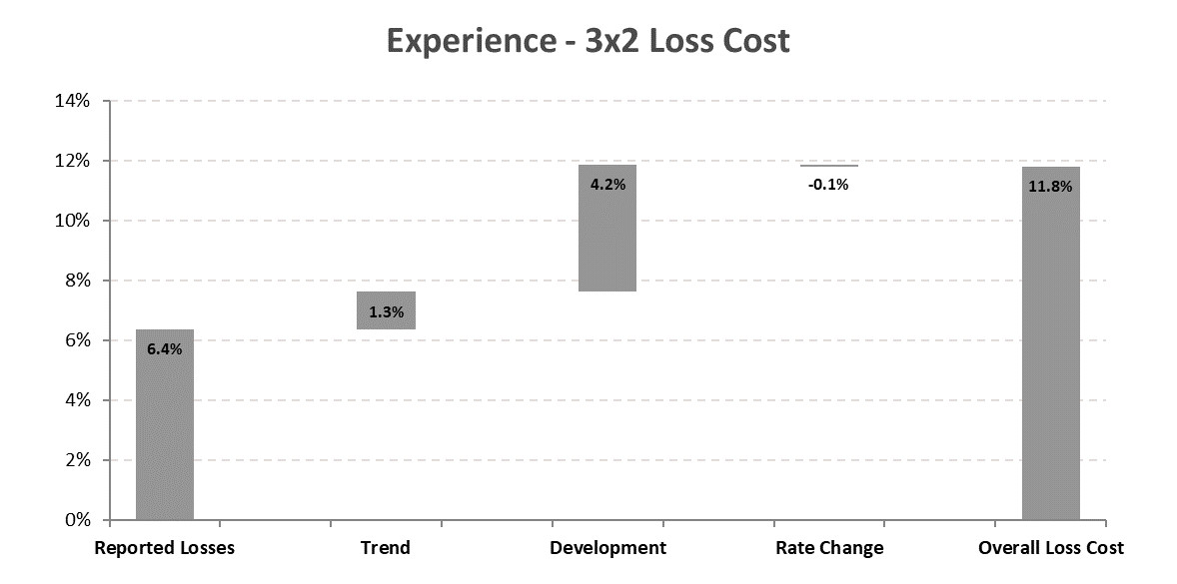
Understand Your Risk : Experience & Exposure XOL Loss Costs
Commentary
Focus: Level of XS Losses & The Impact of Actuarial Assumptions on the Result
An Experience Analysis Uses a Company’s own Claim History to Project Future Excess Losses. There are Only a Few Key Drivers or Assumptions. The Waterfall Chart Displays the Influence of Each Assumption
An Exposure Analysis Uses Industry Loss Assumptions Along with a Company’s Policy Limit Profile to Evaluation Excess Loss Potential
Reinsurers Always Compare these 2 Results and Consider Which is More Credible. Here for a 3x2 Experience Indicates 11.8% while Exposure Indicates a 13.2%
Example Company

Slide 19
Understand Your Risk : Credible Underwriting Risk Measurement
Commentary
Focus: Selecting an Appropriate Measure of Volatility for Stochastic Modeling
Measuring UW Risk is not always Straight Forward. It is a Key Input in the Stochastic Evaluation of Reinsurance Options
Individual Insurance Company Data is not Always Credible
Limit Profiles and Product Offerings Change Over Time which can Further Erode the Ability of Past Experience to Predict the Future
Using the Complete History of Industry UW Experience, It is Possible to Benchmark and Compliment PI’s Indicated Risk Profile to Develop Appropriate Modeling Inputs
Example Company

Slide 20
Evaluate Reinsurance: XOL vs Aggregate Covers - Payoff Diagrams
Simple Reinsurance Payoff
Focus: Benefit of Reinsurance Simple View = Is Net CR Below Gross CR?
Net CR (Grey line) vs Gross CR (Orange Line) is a Simple Way to View Reinsurance Performance Across Various Outcomes
If the Net is Beneath the Gross Line, Reinsurance is Helping
This View does not Provide any Probability or Likelihood of a Certain Scenario or Worse Occurring, but is Very Useful when Ranking Options
Note that the Excess of Loss Option is Rarely Below the Orange Line. Claims Frequency Risk is Being Retained. Reinsurance Options that Cover Claims Frequency can have a Larger Impact on Over All Results
Excess of Loss
AAD QS
(45% Cession, 55% AAD)
Example Company
Aggregate Stop Loss
(25% xs 65%, 100% Cession)
Funds Withheld QS Cashflow View
(70% Cession, 2.5% Crediting Rate)

Slide 21
Evaluate Reinsurance: XOL vs Aggregate Covers - Cost/Benefit Economics
Questions
Focus: Detailed Financial Statistics on the Performance of Reinsurance Options
The Payoff Diagrams are Useful but Do not Always Offer Answers to Specific Questions on Reinsurance Options
Cost: How Much Does My Top & Bottom Line Change?
Stability: How much More Predictable are UW Results? What Volatility Transfer has Occurred?
Capital: How has Reinsurance Aided my Capital Position?
Gross, Ceded and Net Views of the Listed Statistics can Provide the Information to Answer Such Questions
Example Company

Slide 22
Improve Profitability: Financial Profile – Profitability Overview
Observations
Focus: Review Key Elements of XYZ’s Profit
Top Line Increasing
Reliance on Reinsurance Not Large
Except ‘19, Income Growing
Top, Bottom & Ceded Lines
Investment Income = Profit Driver
ER: Stable; Pressure Expected from Larger Future Agency Distribution; PH Div’s Not Included
CY LR Ticking Up
Income Components
Key Item: Reserve Redundancies Evaporating Leading to less UW Cushion in Future CY Results
AY LR Improving; Loss Trend Less than Premium Trend
Losses

Slide 23










WE LICENSE
Touchstone
UNITED STATES
CHINA
Earthquake, Flood, Hurricane, Severe Thunderstorm, Winterstorm, Wildfire, Terrorism
Earthquake, Typhoon, Cyber
AIR produces Catastrophe Models covering most global regions and insurable perils.
AIR delivers results in an event, year, loss table representing 10k - 100k of simulated years for each peril.
INDUSTRY LOSS DATA FOR
Catrader / TouchstoneRe
UNITED STATES
CHINA
AUSTRALIA
Earthquake, Flood, Hurricane, Severe Thunderstorm, Winterstorm, Wildfire, Terrorism
Earthquake, Typhoon
Bushfire, Earthquake, Typhoon
CANADA
CARIBBEAN & CENTRAL AMERICA
EUROPE
Earthquake, Severe Convective Storm, Windstorm, Winterstorm
Hurricane, Earthquake
Earthquake, Extra-Tropical Cyclone, Flood
JAPAN
NEW ZEALAND
SOUTH AMERICA
Earthquake, Typhoon
Earthquake
Earthquake

Slide 24

WE LICENSE
RiskLink
UNITED STATES
CANADA
Earthquake, Hurricane, Severe Thunderstorm, Winterstorm, Terrorism
Earthquake, Hurricane, Severe Thunderstorm, Winterstorm
RMS produces Catastrophe Models covering most global regions and insurable perils. RMS delivers results in an event loss table with annual rates for each event.
RMS has a simulation platform to create event, year, loss tables and Howden Tiger produces our own simulation of events available in TigerEye.
EUROPE
CHINA
Earthquake, Extra-Tropical Cyclone, Inland Flood
Earthquake, Typhoon
INDUSTRY EXPOSURE AND LOSS DATA FOR
UNITED STATES
EUROPE
Earthquake, Hurricane, Severe Thunderstorm, Winterstorm
Extra-Tropical Cyclone, Inland Flood
CARIBBEAN
JAPAN
Earthquake, Typhoon
Earthquake, Typhoon

Slide 25
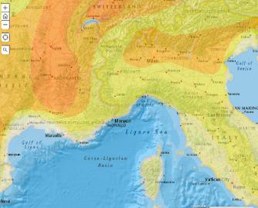



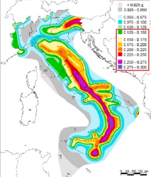




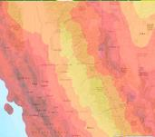


Many other catastrophe models are supported in the US and around the world

Slide 26
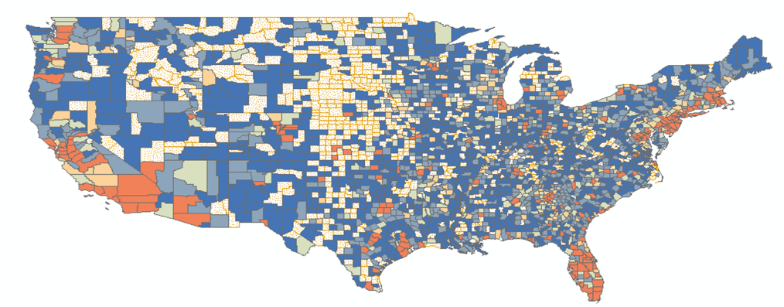
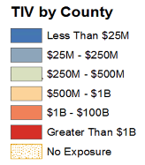
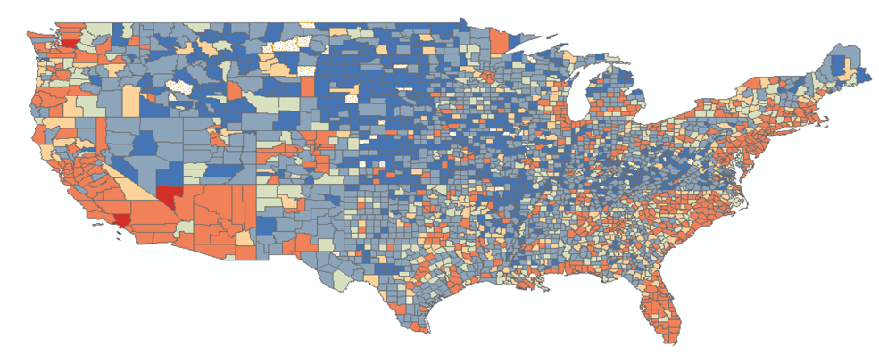
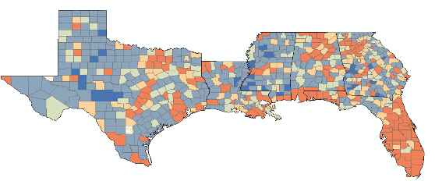
Understand Your Risk: Exposure Review
Major Areas of Loss Potential:
Northeast and New England
Florida
SE Coast (SC, NC and GA)
Potentially room to grow on Texas coast
Note: RMS RiskLink v17_Data as of end of Treaty Year

Slide 27
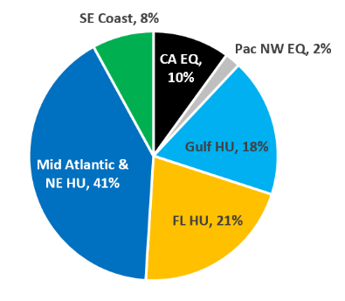
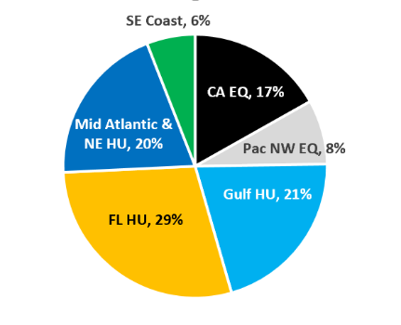
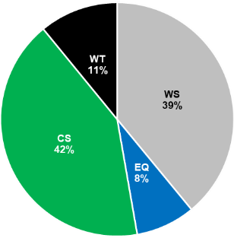
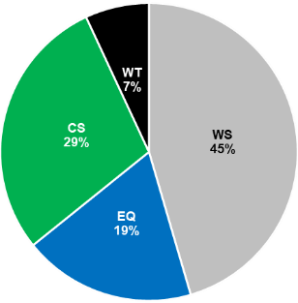
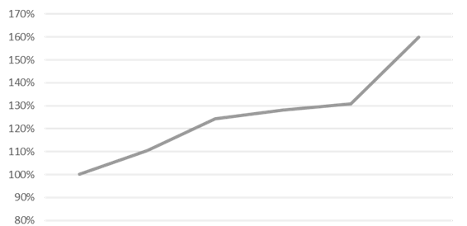
Understand Your Risk: Exposure Review
Current vs. Projected AAL¹ by Region
Current vs. Projected Peril Breakdown
¹ Total portfolio AAL by region using RMS RiskLink v17 – OEP as of 4/30/2020
¹ Total portfolio AAL by region using RMS RiskLink v17 – OEP as of 4/30/2020
EL² Increases Significantly with New Units
Combined Portfolio Assumptions
² End of treaty year EL for each program using RMS RiskLink v17

Slide 28
Understand Your Risk: Exposure Review

Slide 29
Understand Your Risk: Understanding Model Inputs
The Portfolio Loss Results Can Be Improved By Collecting More Data on Roof Deck Attachment, Window Protection, and Wall Siding
Once the High Importance Secondary Modifier Data Has Been Collected, We Can Go Down the List
Florida Clients Usually Collect 8-10 Secondary Modifiers – Verifiability and Accuracy Important For Reinsurance Markets

Slide 30
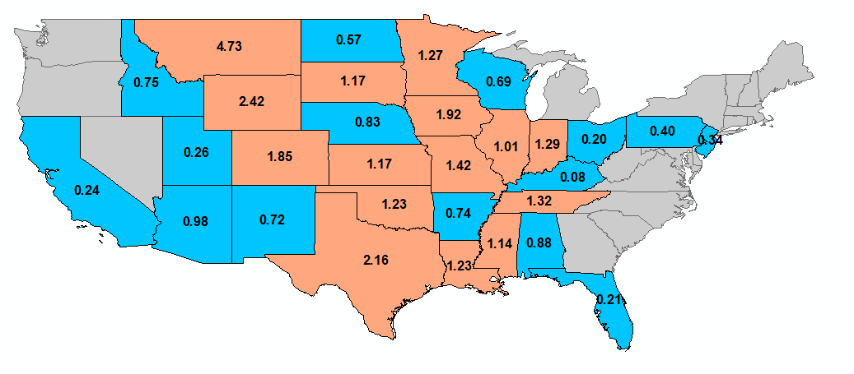
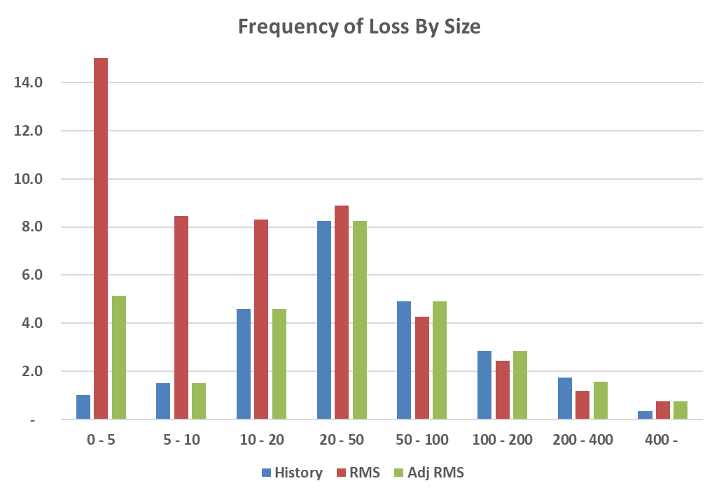
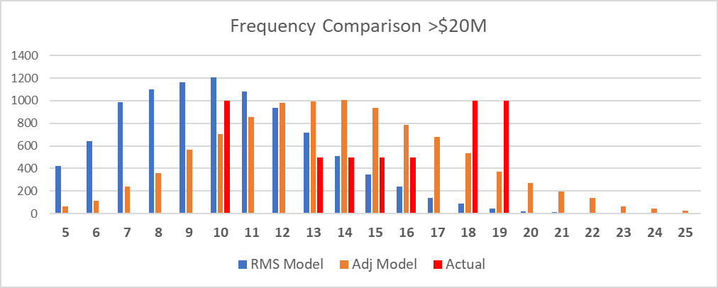
Understand Your Risk: Calibrating the Models
Understanding and calibrating the models to fit XYZ’s view of risk is critical
Understand how the models behave and how they fit XYZ’s risk profile
Each peril has unique challenges
Wildfire
Frequency / Severity of CS/WT
Major Perils HU/EQ
This understanding also allows us to structure & market your program appropriately and ensure adequate primary pricing
Geographic Adjustments
46
* Illustrative Sample

Slide 31
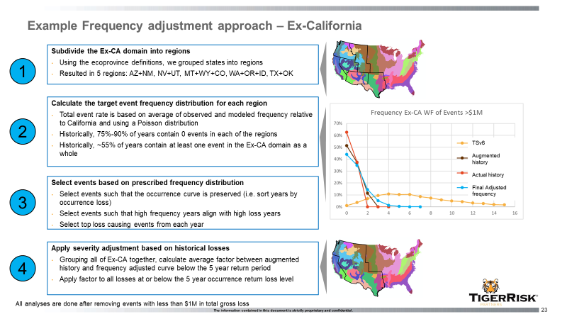
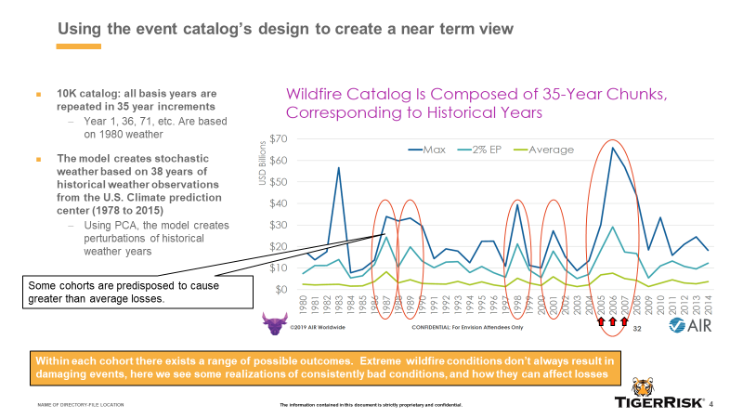
Understand Your Risk: Calibrating the Models
Considerations of history (both long term and short term), observed frequency, model output is critical for creating a view of risk in low severity high frequency perils

Slide 32
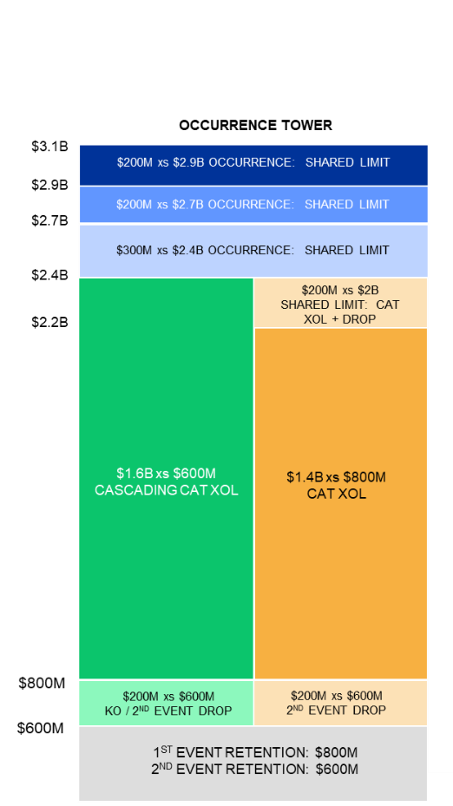
Evaluate Reinsurance: Cost and Effectiveness
Outcome
Focus: Benefit of Reinsurance
Structure saves +$55M and solves successfully all capital tolerances
Limit efficiency is at the core of our proposal. We utilize a combination of per event and aggregate solutions with less, but more effective, limit
Each structural component is the result of thorough deconstruction and portfolio, its drivers and Liberty’s stated goals
We include a hedge on Reinsurance (“non-subject”) business with a Repli-Cat program as well as coverage in the ventilated Middle Agg Layer
Aggregate coverage is far more valuable than models suggest; history is a key component and included in our analysis - resulting in $200m of increased as if recoveries
Have Incorporated earnings protection that also provides benefit on stated risk tolerances

Slide 33
Improve Profitability: Policy Ranking
AIR Model View for Illustrative Purposes. Customizable to Client’s View of Risk and Granularity of Non-Cat and Expense Data Available.
Reinsurance Cost Ratio = Private Reinsurance Cost Over Premium
CAT Cost Ratio = (Private Reinsurance Cost + Net of CAT Layer
Recoveries Up to Top of Reinsurance Tower) Over Premium
Divide Policies Into Four Categories Based on Combined Loss Ratio (CLR)
A: CLR Less Than 80%
B: CLR Between 80% and 100%
C: CLR Above 100%
D: PREMIUM - ALLOCATED PRIVATE REINSURANCE COST – EXPENSES < 0

Slide 34
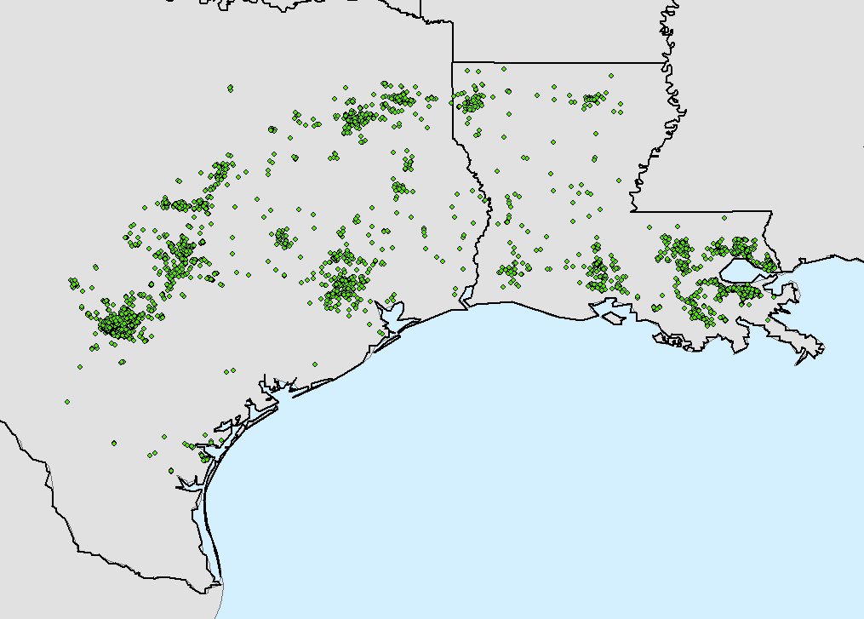
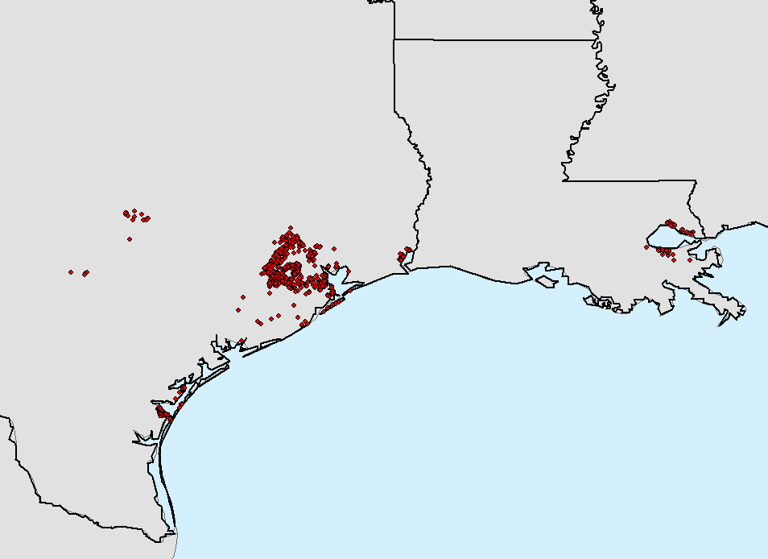
Improve Profitability: Policy Ranking
Group A Policies
Group D Policies
Year Built Bands and Roof Covering are 2 Factors That Explain Groups A & D Partially

Slide 35
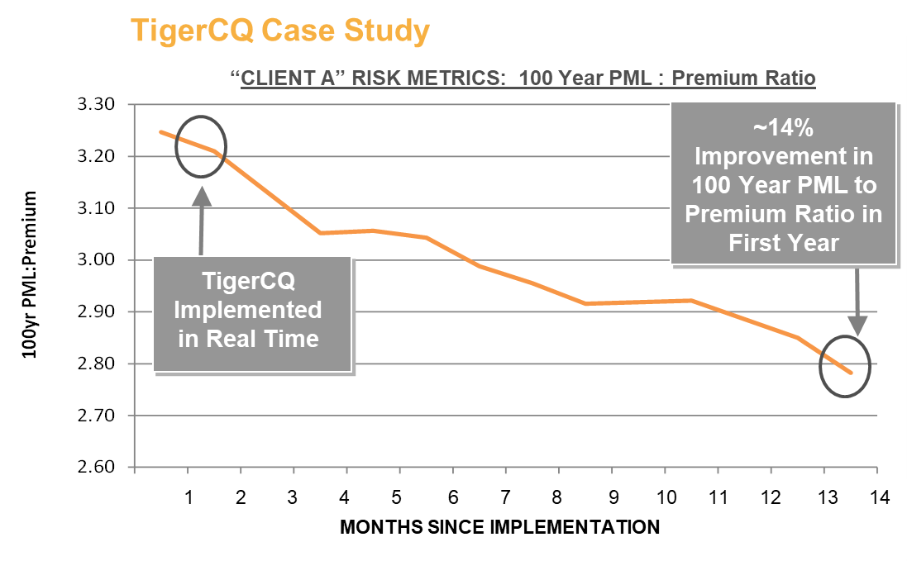
Improve Profitability: Cat Underwriting with TCQ
TigerCQ (CAT Quotient) Will Help Integrate Reinsurance Cost to Policy Level Pricing and UW
Existing Agent Platform
Existing Agent UW System Used to Collect TigerCQ Inputs
Policy Financial Structure: Values, Deductibles, etc.
Building Characteristics: Address, Occupancy, Construction, Year Built, Number of Stories, Secondary Modifiers (Where Applicable)
TigerCQ Calculates
Expected Loss Estimation
Marginal Reinsurance Cost, Recovery Estimation
Surplus Charge Estimation (if Applicable)
Company Specific Metrics
CAT Quotes Can Be Combined With Non-CAT, Expense Estimates, and Other Company Specific Criteria
Result
Estimated CAT Quotient → Real-Time Policy Underwriting Decision
TigerCQ
Database
Company Specific Metrics
Identify Issues Before Policies are Bound
Quote or Underwriting Decision Matrix

Slide 36
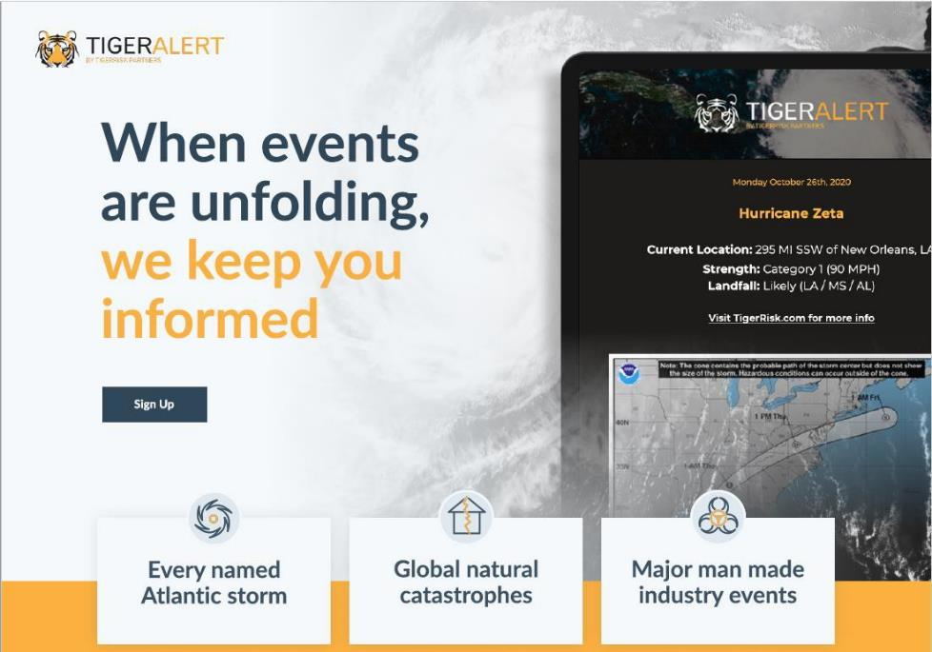
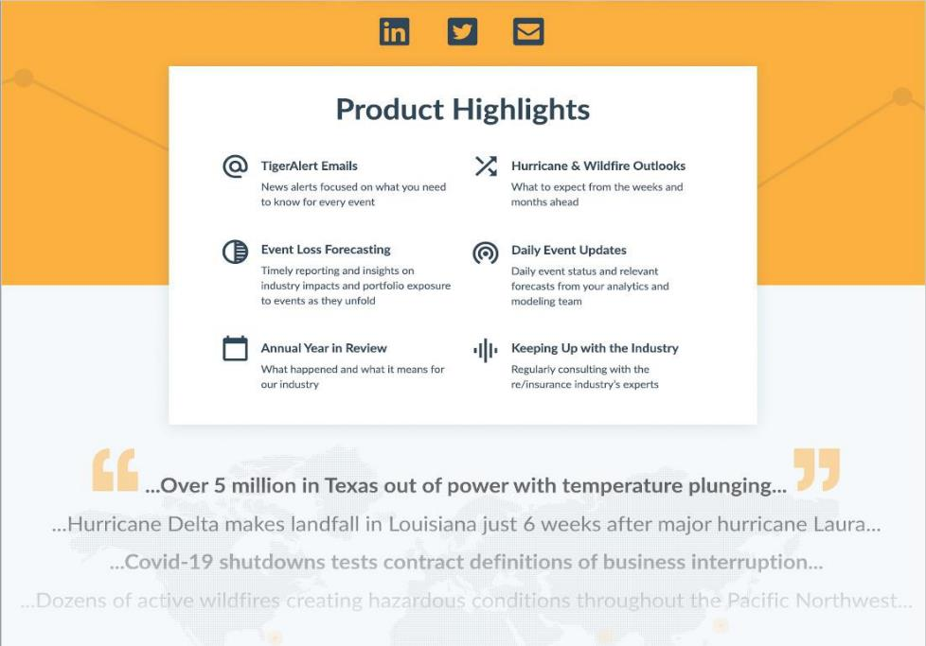
Event Response: TigerAlert

Slide 37
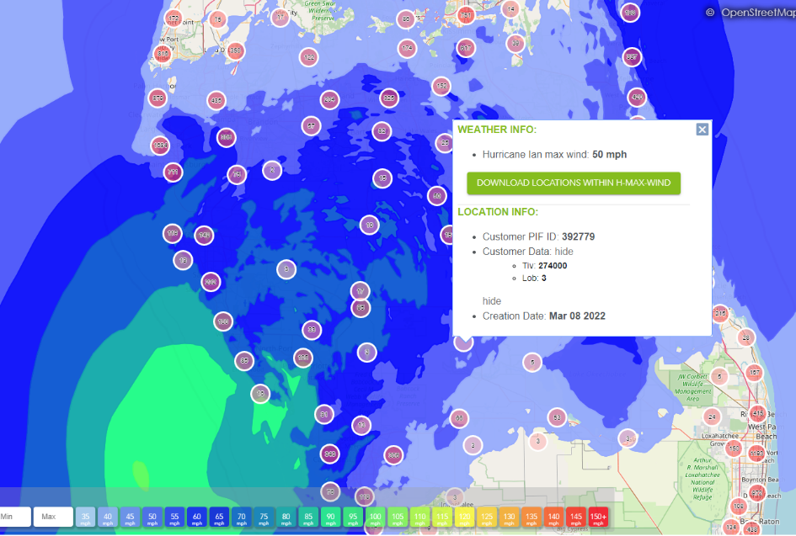
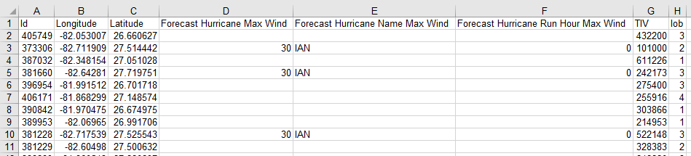
Event Response: TigerAlert
Visualization
…And Data to Back it Up

Slide 38
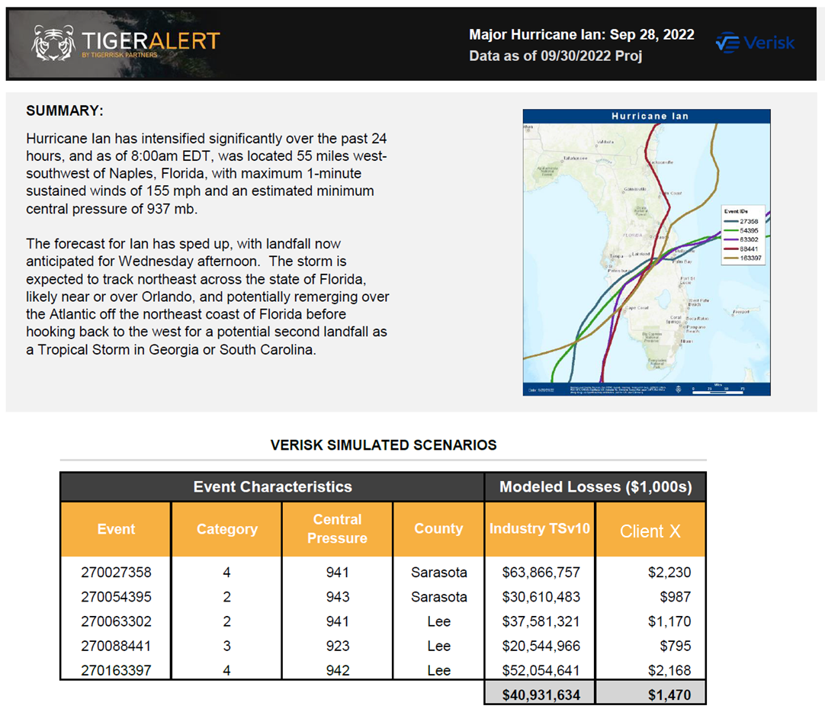
Event Response: TigerAlert – Loss Estimates
Leading up to the event, it was clear that some model vendor event selections were not going to accurately reflect the event
We advised clients to use a subset of events and consider the individually identified scenarios rather than the average that may be biased too low

Slide 39

ANALYTICS SUMMITS
Custom Views Of Risk
SCS/WT
Hurricane
Wildfire
Others
Live Event Modeling
CAT Loss Development
Concentration Management
Models v Experience
Climate Change
Verisk “Next Gen” Financial Module
Winter Storm Model Updates
Understanding PCS
Secondary Modifiers
CAT Model Updates
AIR SCS
RMS Winter Storm
Others
Capitalization Metrics And Benchmarks
Introduction to BCAR / S&P CAR
Industry Volatility
Volatility Emergence over Time
Individual Rating Agency Review (ROAR)
Risk Index
Portfolio Profitability Analysis
Sector Research
Inflation

